Slide 1
H1B VISA PROJECT
BY
D.RANJITHA
S181165200237

Slide 2
What is Big Data?
Big Data is a collection of large datasets that cannot be processed using traditional computing techniques. It is not a single technique or a tool, rather it involves many areas of business and technology.

Slide 3
Five Vs of Big Data:
Volume :Scale of data
Velocity :Analysis of streaming data
Variety : Different forms of data
Veracity :Uncertainty of data
Value: Usability of data

Slide 4
Hadoop:
Hadoop is an Apache open source framework written in java that allows distributed processing of large datasets across clusters of computers using simple programming models.

Slide 5
Hadoop Architecture at its core has two major layers namely:
Processing/Computation layer (MapReduce), and
Storage layer (Hadoop Distributed File System).

Slide 6
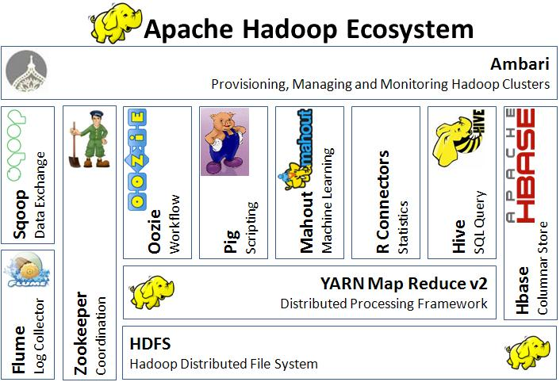
Hadoop Ecosystem:

Slide 7
Hadoop Distributed File System:
The Hadoop Distributed File System (HDFS) is based on the Google File System (GFS) and provides a distributed file system that is designed to run on commodity hardware. It has many similarities with existing distributed file systems. However, the differences from other distributed file systems are significant. It is highly fault-tolerant and is designed to be deployed on low-cost hardware. It provides high throughput access to application data and is suitable for applications having large datasets.

Slide 8
MapReduce:
MapReduce is a parallel programming model for writing distributed applications devised at Google for efficient processing of large amounts of data (multi-terabyte data-sets), on large clusters (thousands of nodes) of commodity hardware in a reliable, fault-tolerant manner. The MapReduce program runs on Hadoop which is an Apache open-source framework.

Slide 9
Hive:
Hive is data warehousing software that addresses how data is structured and queried in distributed Hadoop clusters. Hive is also a popular development environment that is used to write queries for data in the Hadoop environment.

Slide 10
Pig:
Pig is a procedural language for developing parallel processing applications for large data sets in the Hadoop environment. Pig is an alternative to Java programming for MapReduce, and automatically generates MapReduce functions.

Slide 11
HBase:
HBase is a scalable, distributed, NoSQL database that sits atop the HFDS. It was designed to store structured data in tables that could have billions of rows and millions of columns

Slide 12
Oozie:
Oozie is the workflow scheduler that was developed as part of the Apache Hadoop project. It manages how workflows start and execute, and also controls the execution path

Slide 13
Sqoop:
Think of Sqoop as a front-end loader for big data. Sqoop is a command-line interface that facilitates moving bulk data from Hadoop into relational databases and other structured data stores.

Slide 14
Zookeeper:
ZooKeeper is a distributed co-ordination service to manage large set of hosts. Co-ordinating and managing a service in a distributed environment is a complicated process. ZooKeeper solves this issue with its simple architecture and API.

Slide 15
In this project we will be performing analysis on the H1B visa applicants between the years 2011-2016. The H1B is an employment-based, non-immigrant visa category for temporary foreign workers in the United States. For a foreign national to apply for H1B visa, an US employer must offer a job and petition for H1B visa with the US immigration department.

Slide 16
Tools used in the project:
1.MapReduce
2.Pig
3.Hive
4.Scoop

Slide 17
Conclusion:
Thus the H1B Visa data has been analysed with queries and coding using tools like mapreduce, pig, hive and scoop and corresponding results have been obtained and saved.

Slide 18
Thank You

